Slide 1
Current Soil Moisture Conditions and MT Mesonet Update
5/9/2024
Dr. Zachary Hoylman
Assistant State Climatologist - Montana Climate Office
Research Professor - University of Montana

Slide 2
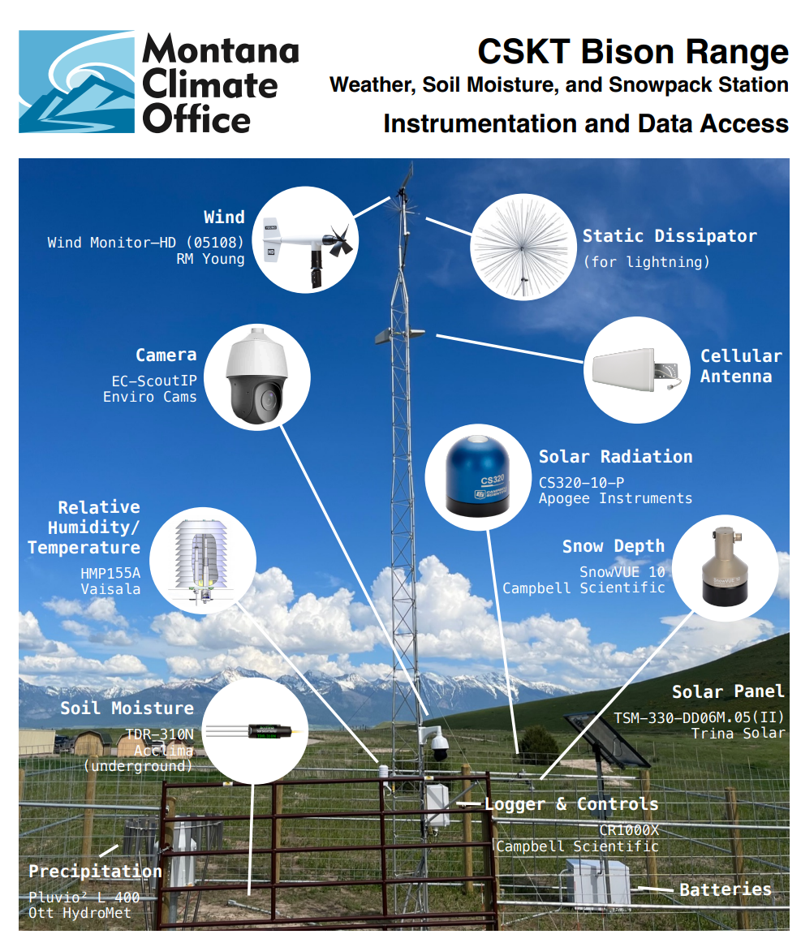
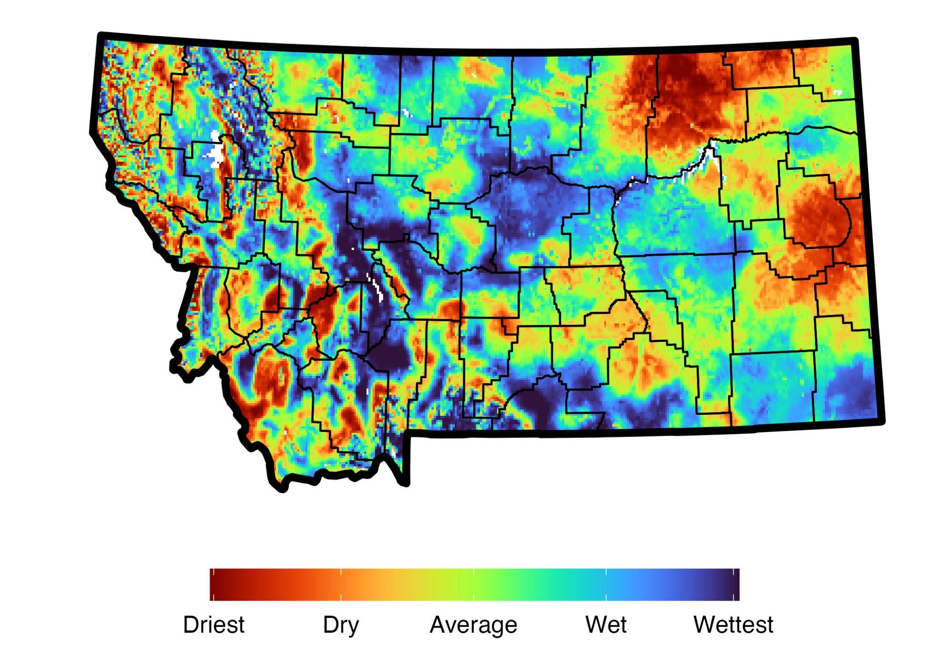
How do we Monitor Soil Moisture?
STATION DATA
Montana Mesonet
MODELLED DATA
Pros:
- Spatially Continuous
- Near Real Time
- Long POR
Cons:
- Accurate?
- Might not reflect local conditions
Pros:
- Accurate
- Real-time
- Vertical Info.
Cons:
- Point Info.
- Short POR
- Expensive

Slide 3
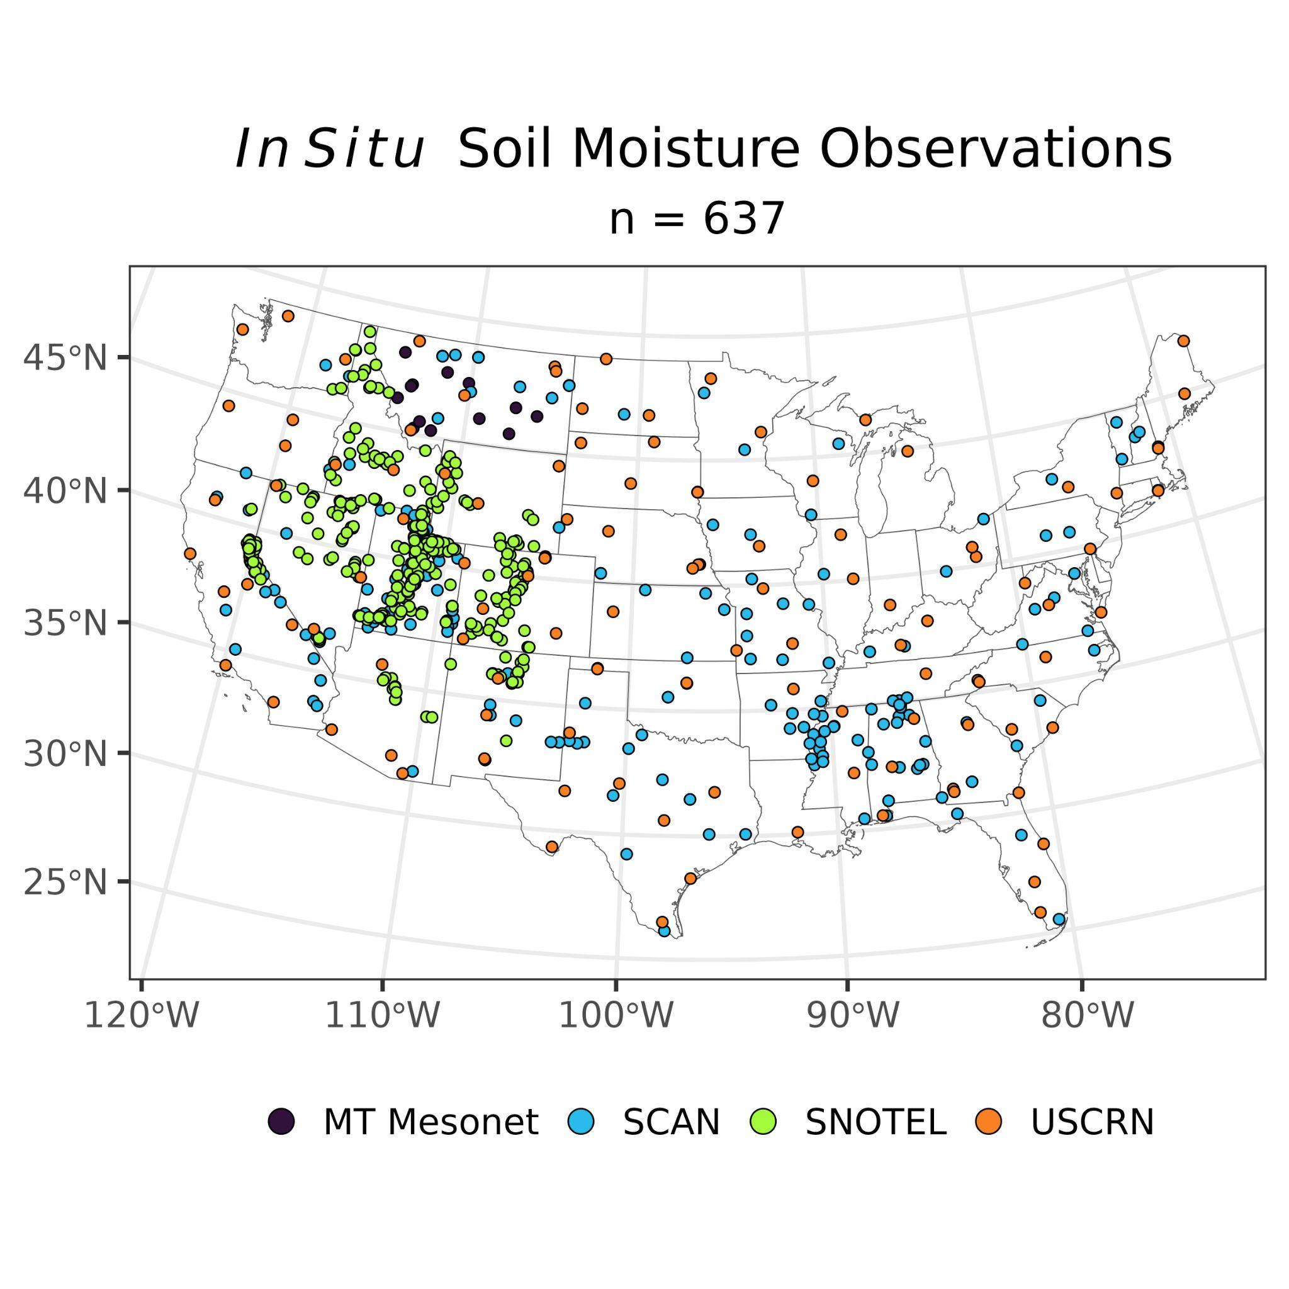
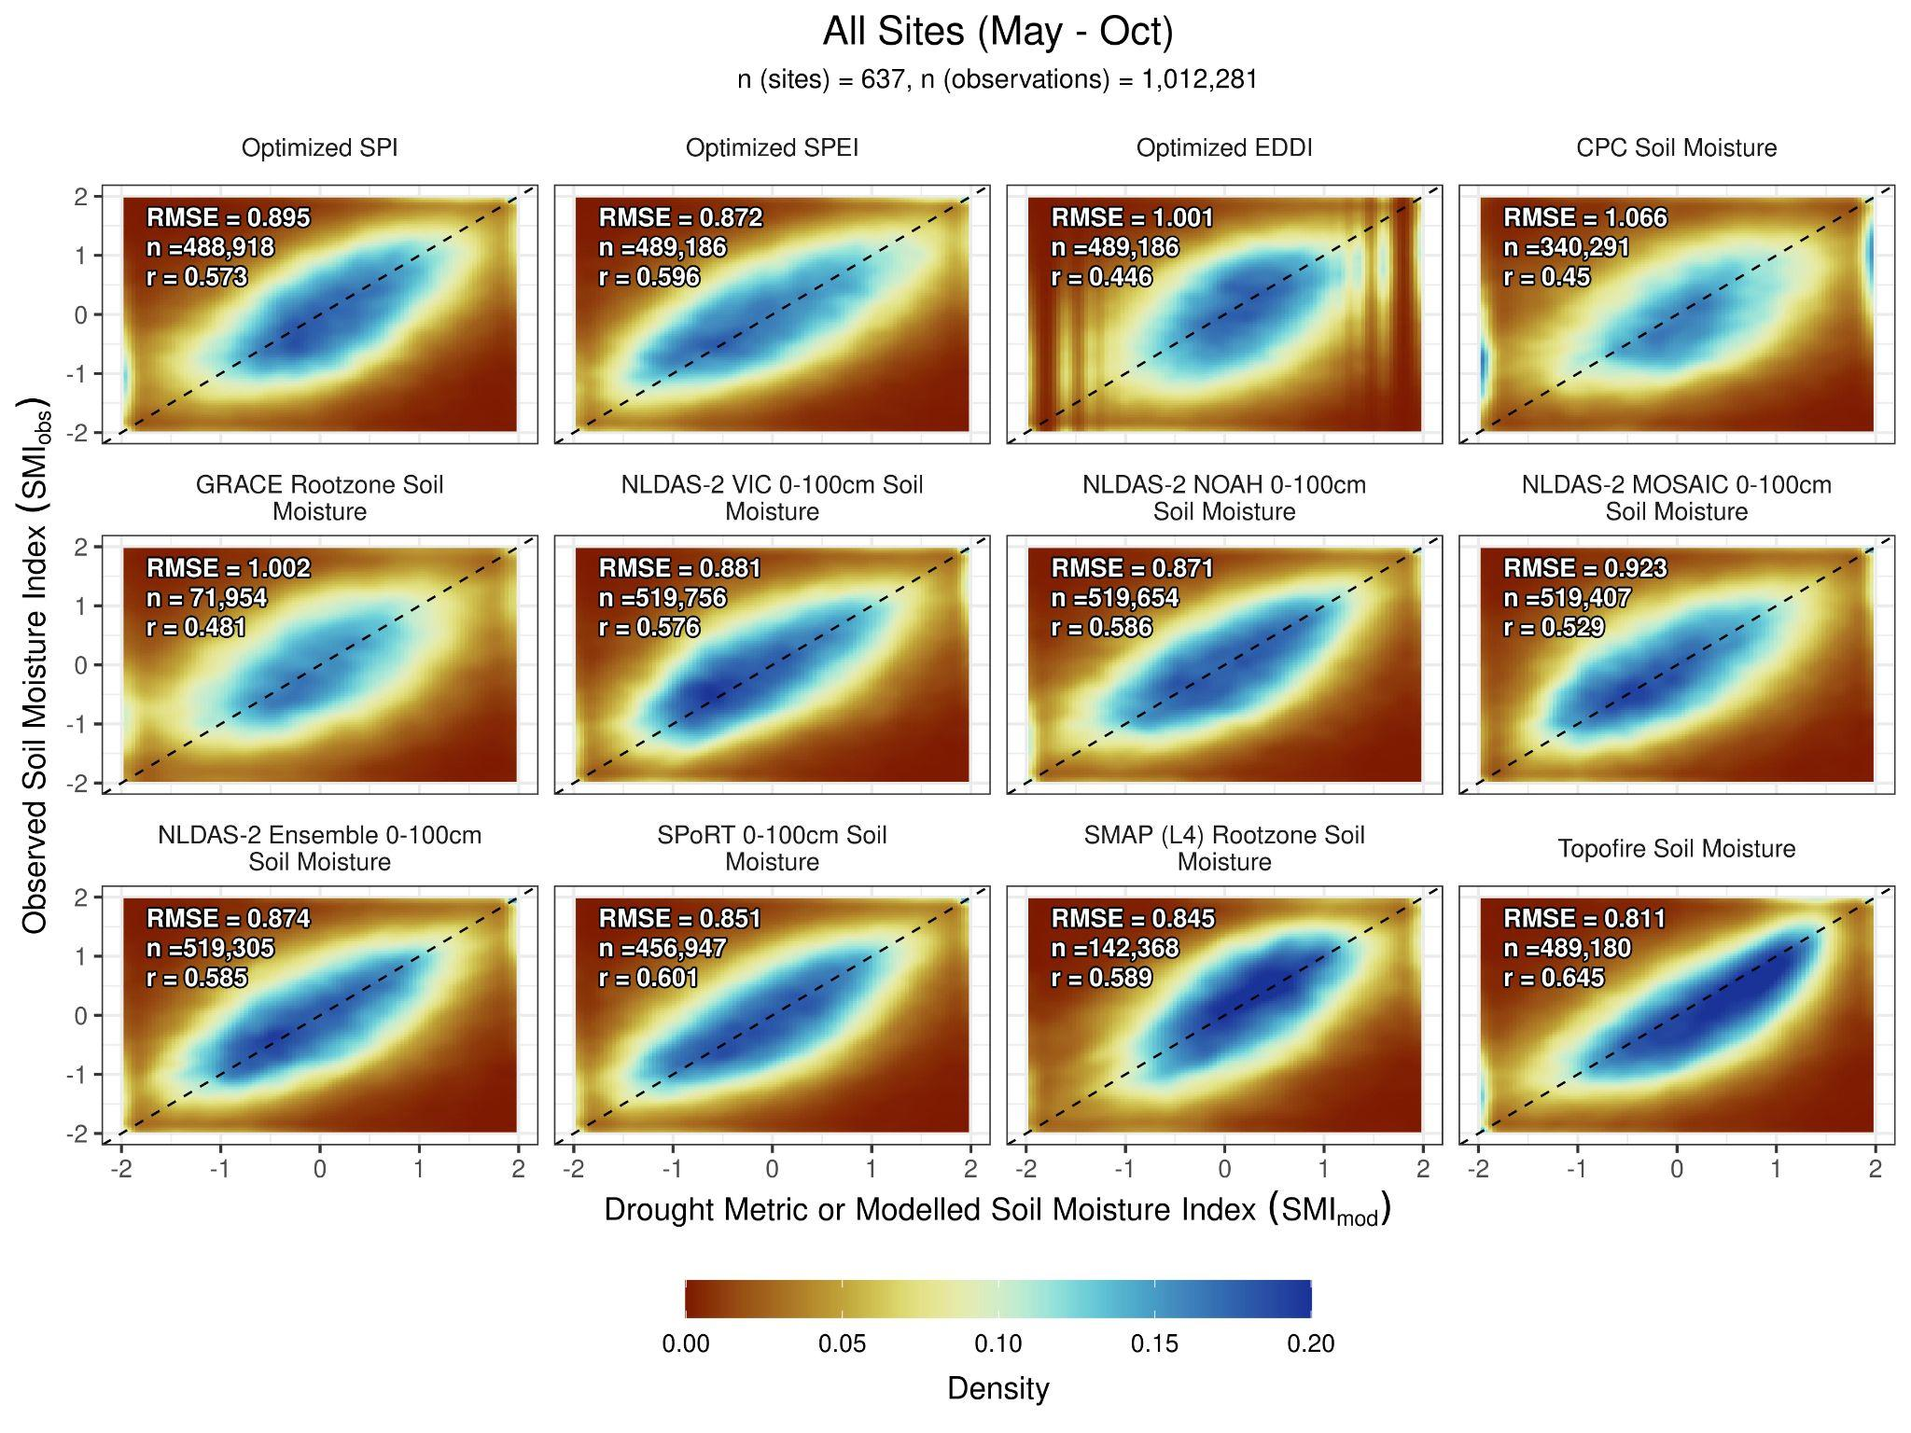
Which Models Work Best?

Slide 4
Which Models Work Best?
SPoRT LIS Soil Moisture is the best model for detecting drought

Slide 5
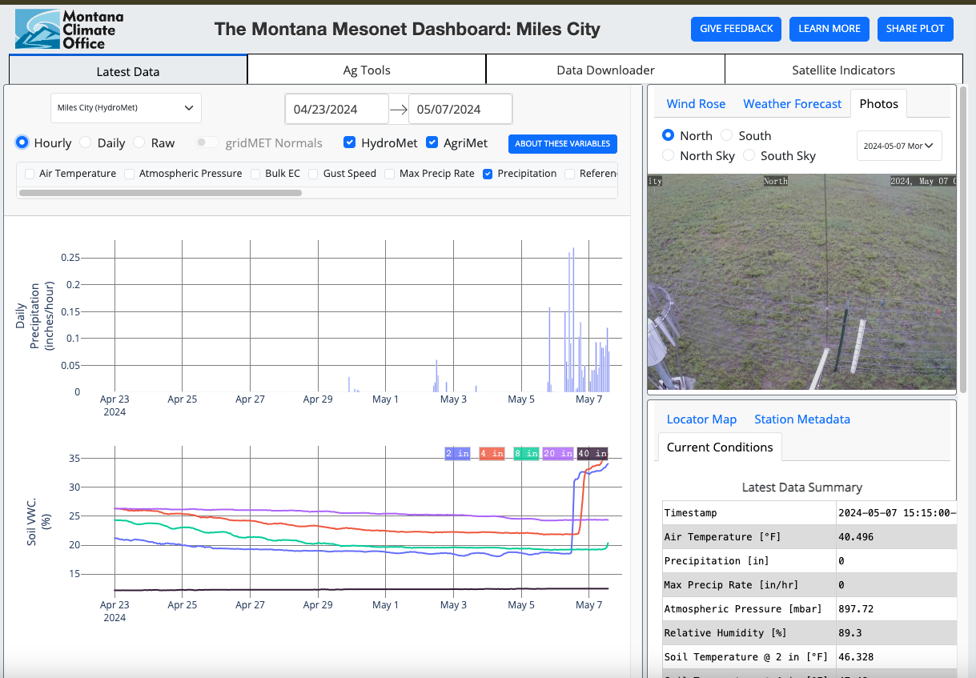
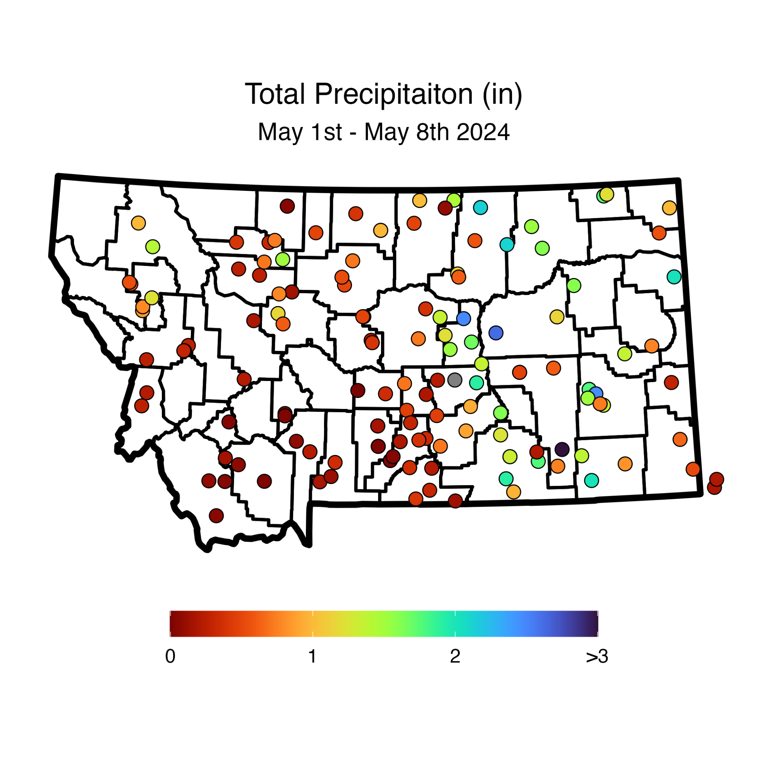
Current Conditions - Recent Changes
Using the Montana Mesonet
Montana Mesonet Dashboard
https://mesonet.climate.umt.edu/
Soil Moisture Recharge!
Soil Moisture

Slide 6
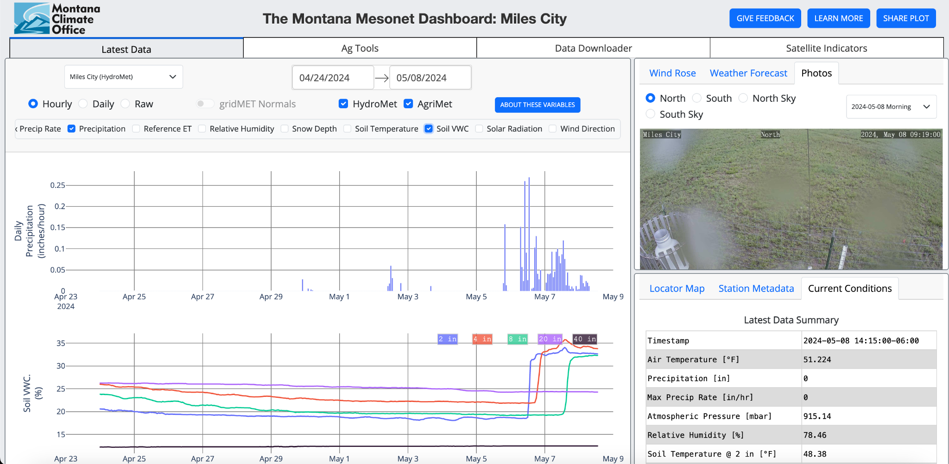

Slide 7
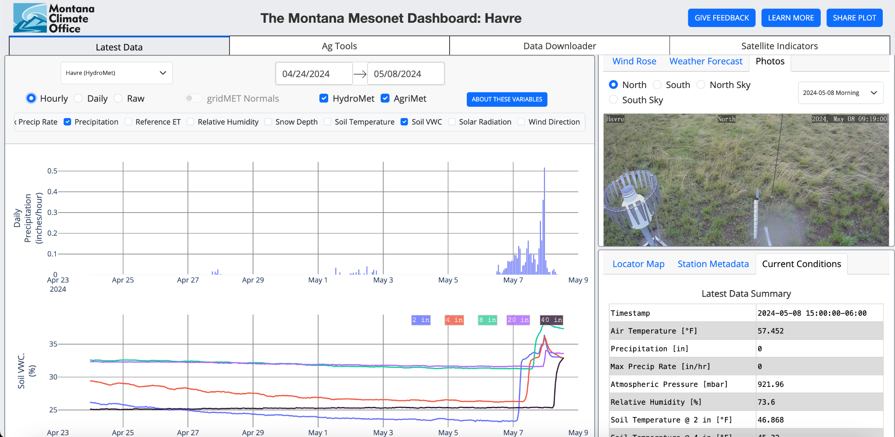

Slide 8
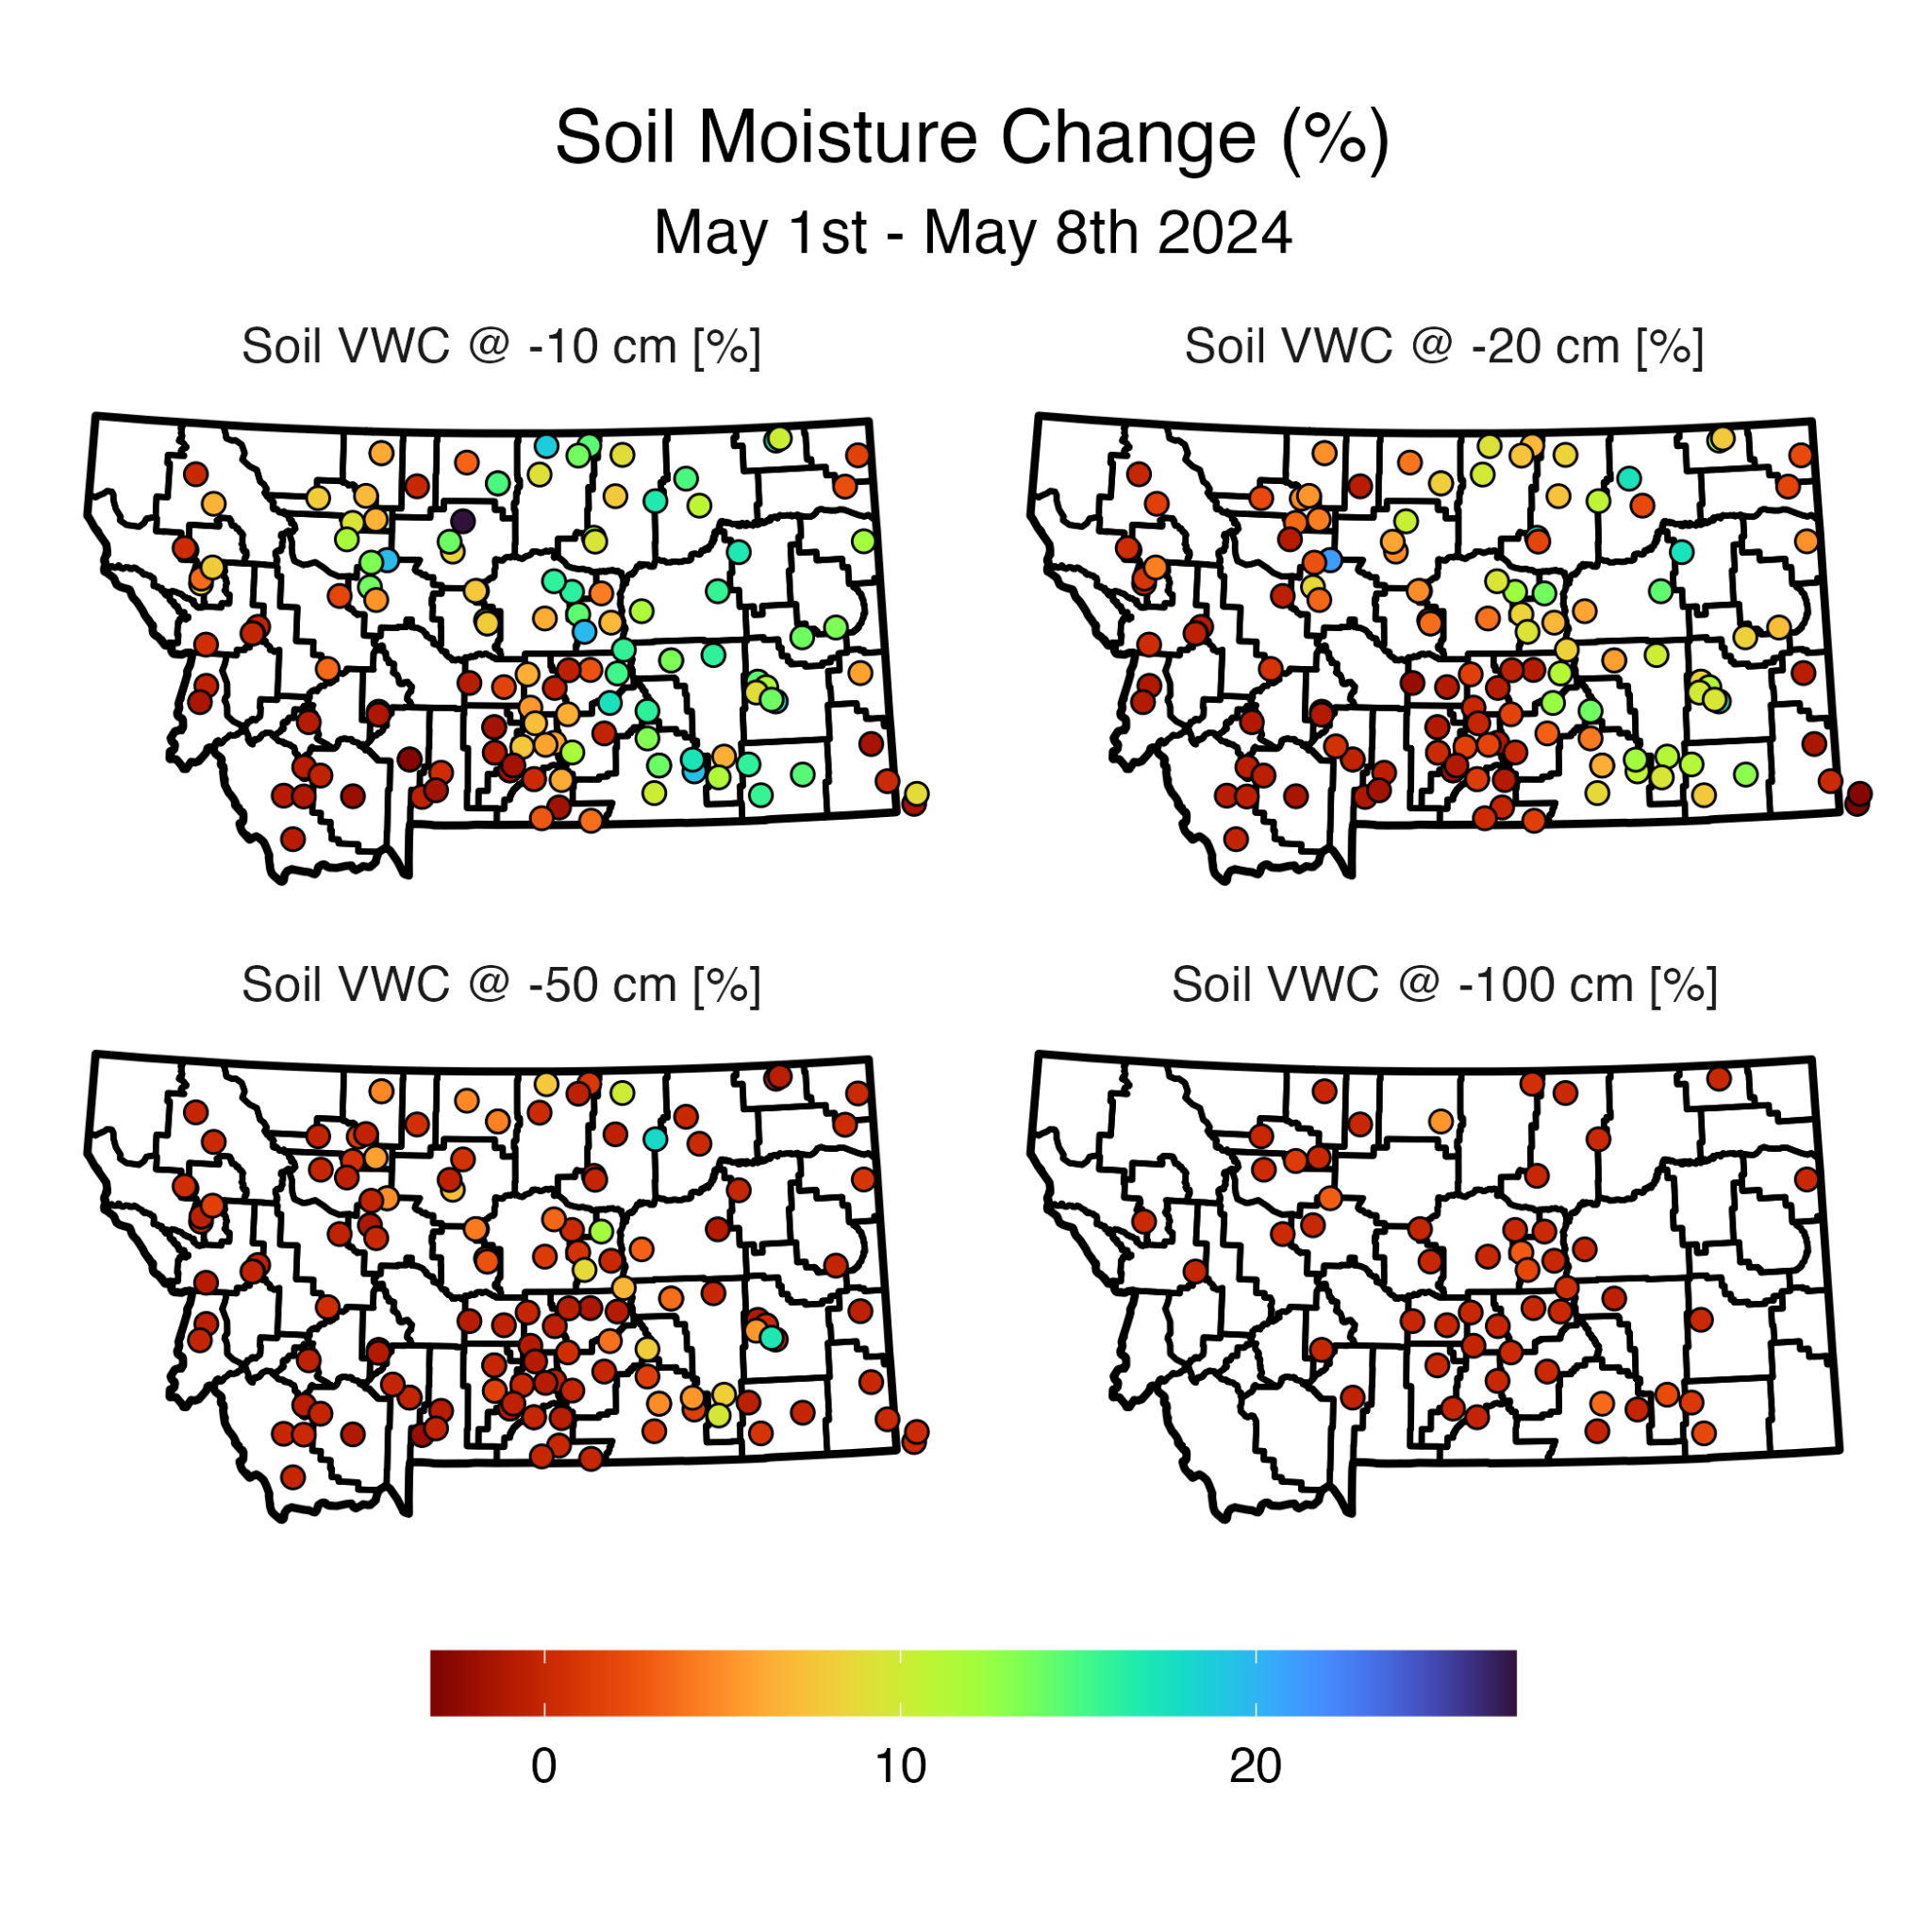
Current Conditions - Recent Changes
Using the Montana Mesonet

Slide 9
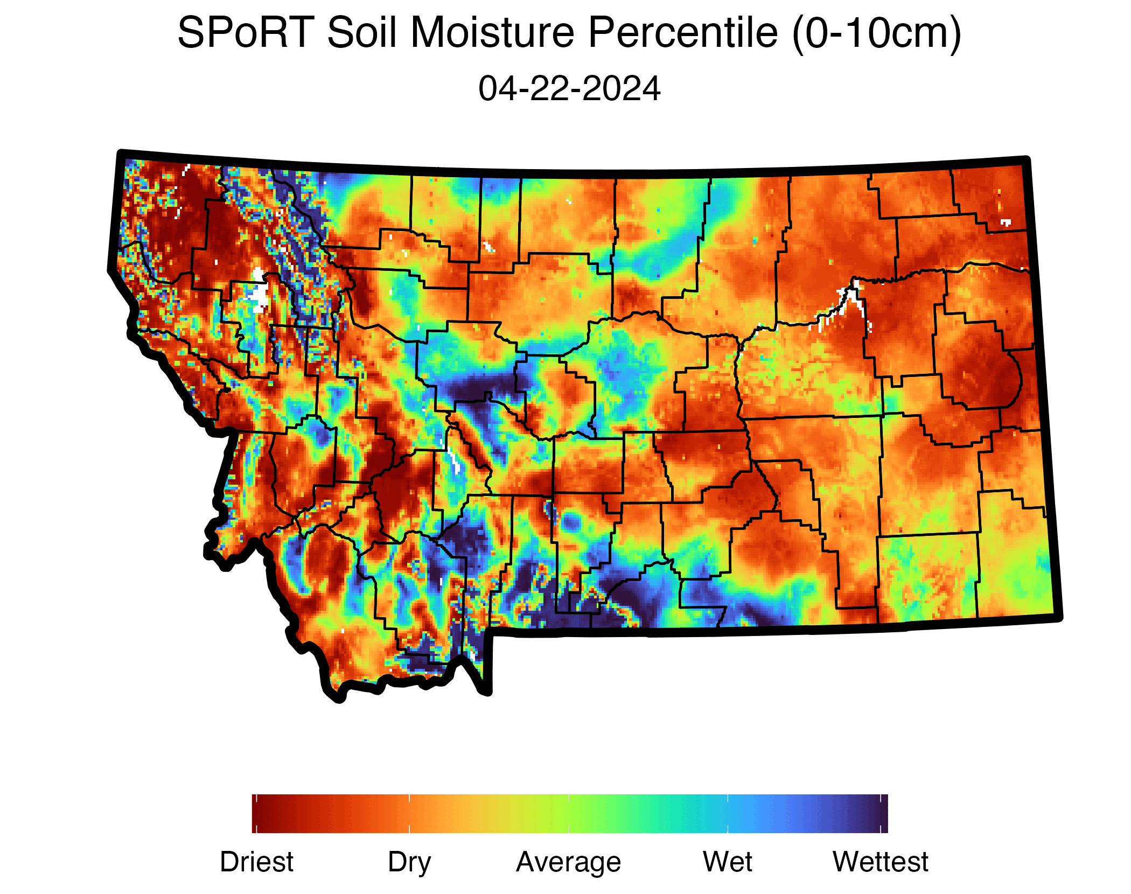
Current Conditions - Recent Changes
Using the SPoRT LIS Model (0-10cm)
Significant shallow recharge in east
Model agrees but over emphasizes in WC MT & NE/SE corners

Slide 10
Current Conditions - Recent Changes
Using the SPoRT LIS Model (0-40cm)
Moderate middle recharge in east
Models over emphasize in central

Slide 11
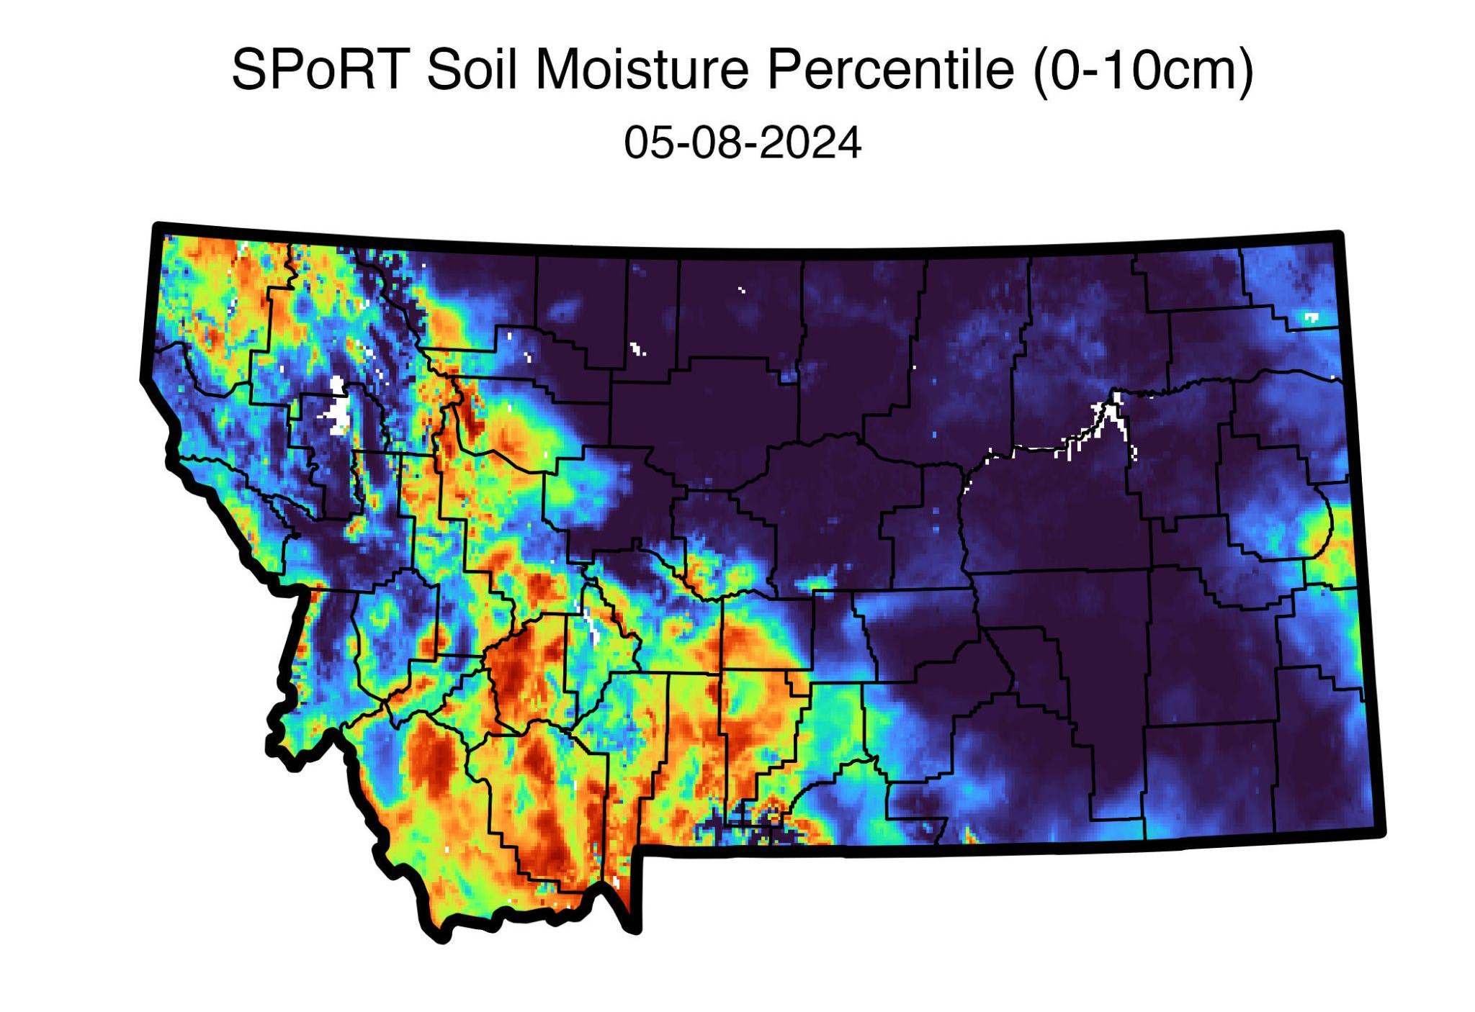
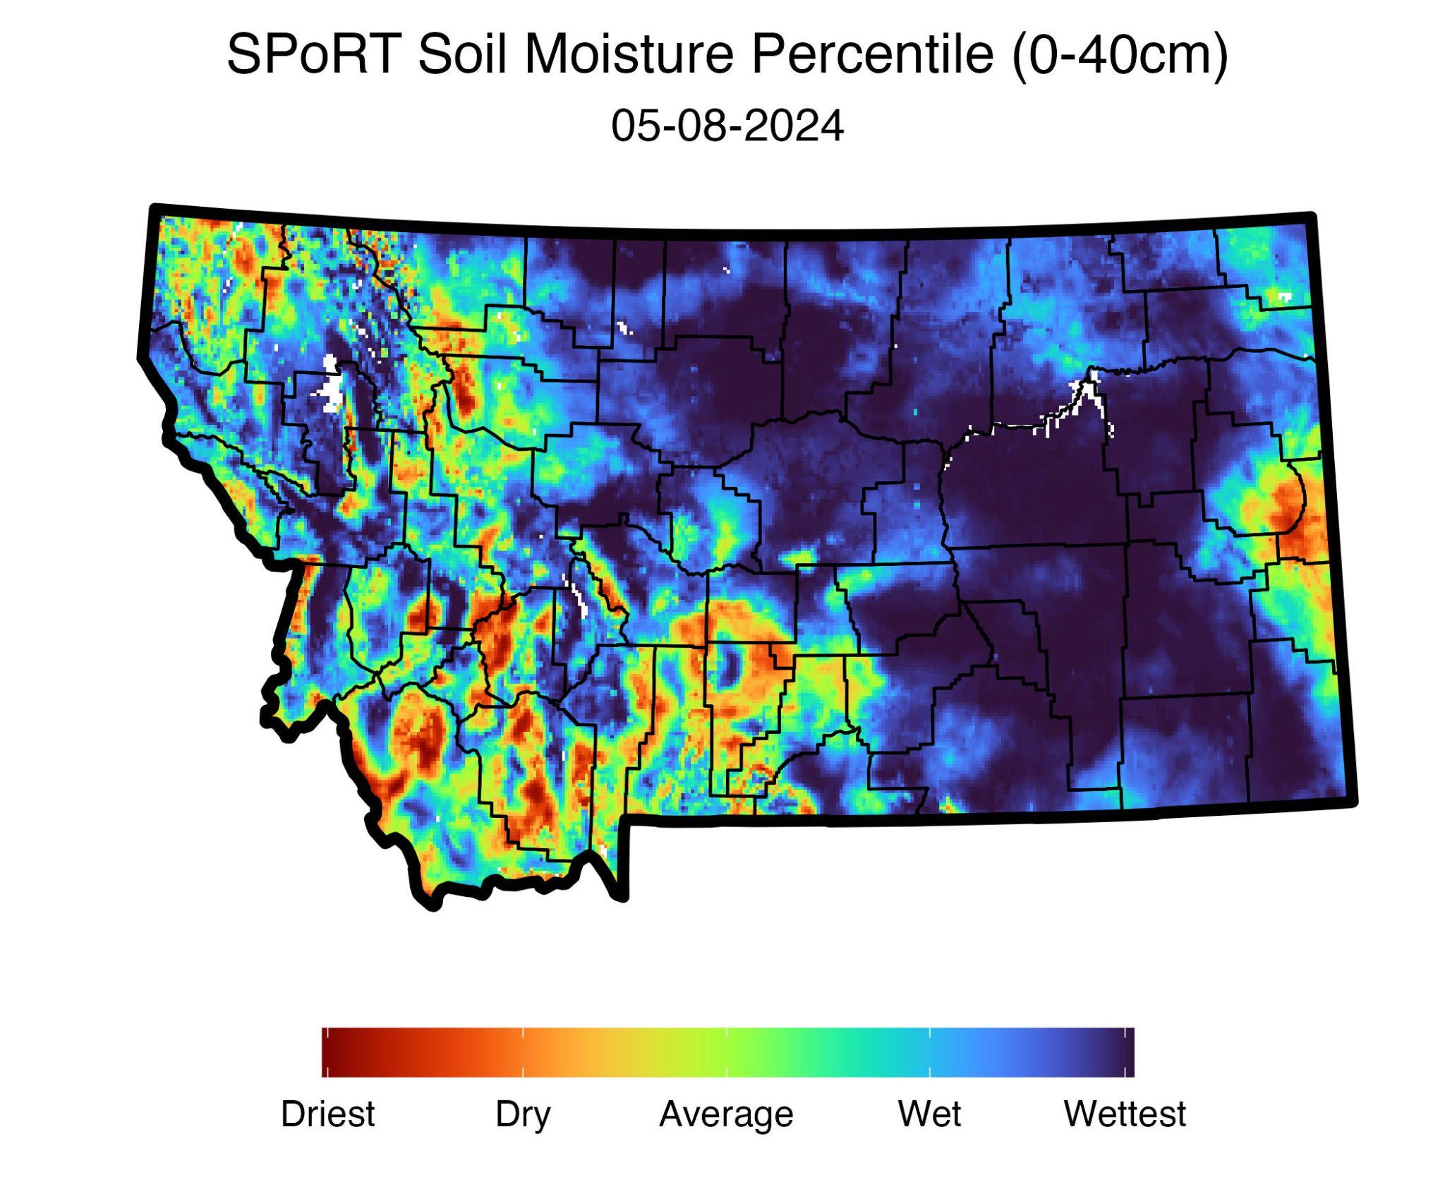
Soil moisture has improved, but only within shallow soils (very little response at 20+ in)
Models are performing well but are over emphasizing in some locations (WC, NC, NE, SE)
Importance of matching station/model data (we need to be critical consumers)

Slide 12
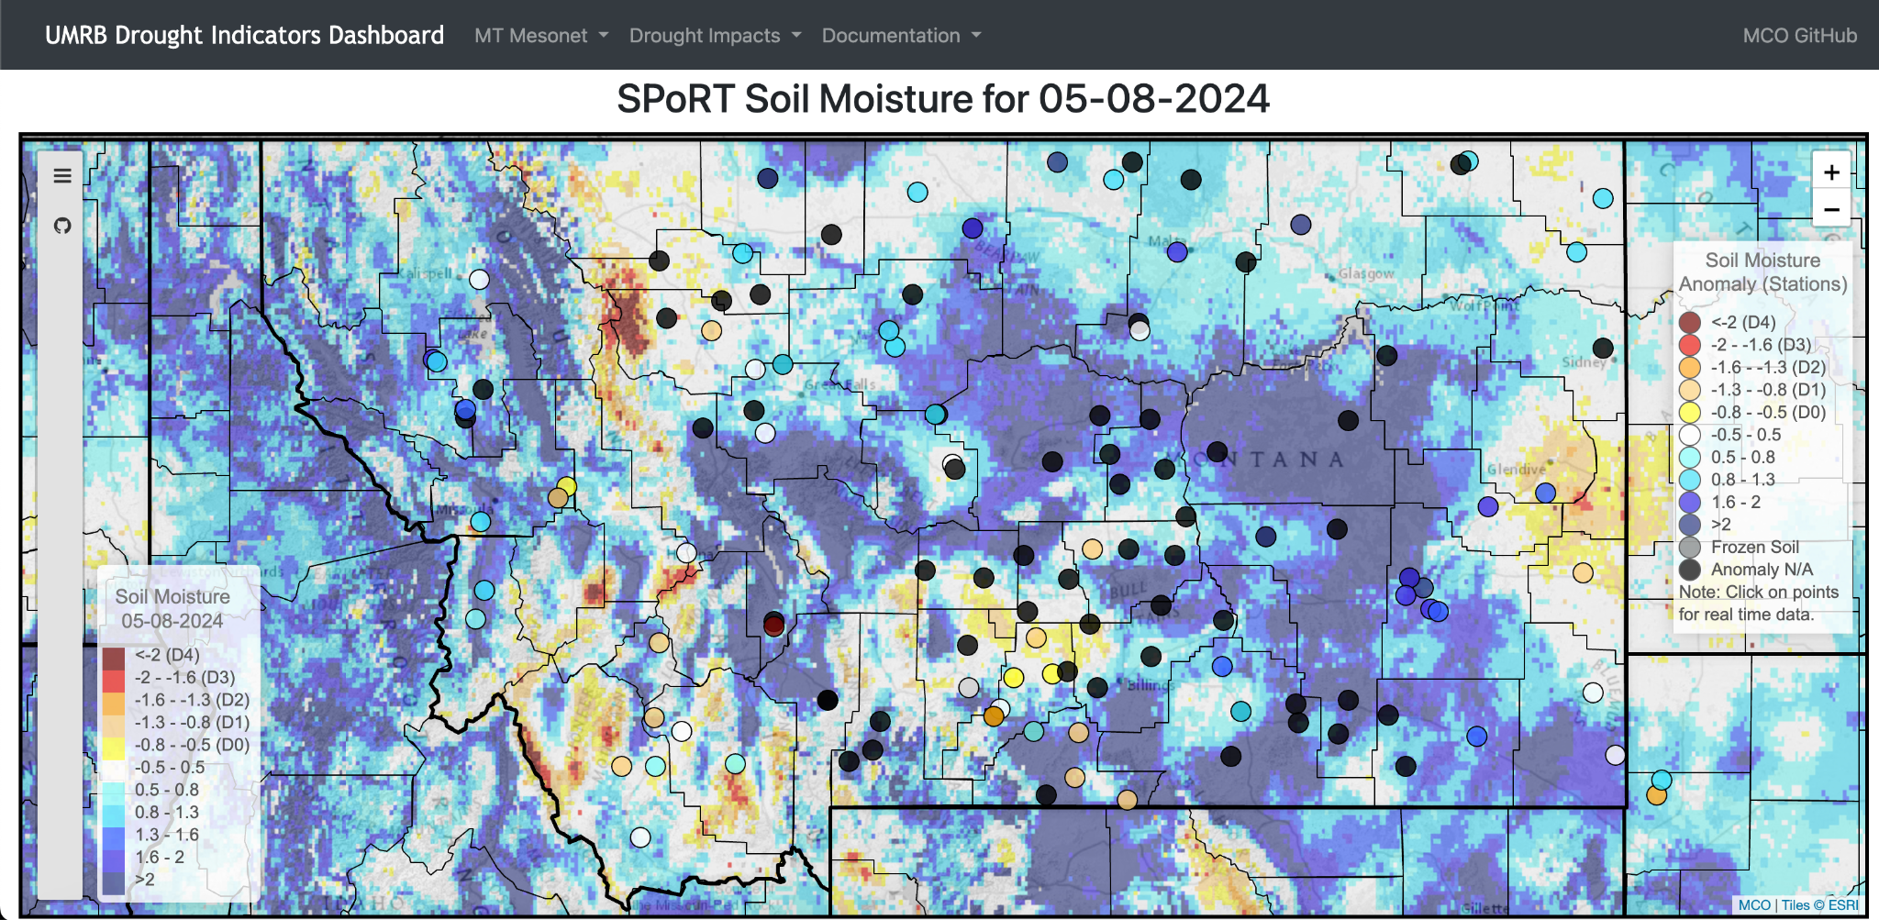
Current Conditions - Anomalies
Using the Montana Mesonet
UMRB Drought Dashboard
https://drought.climate.umt.edu/

Slide 13
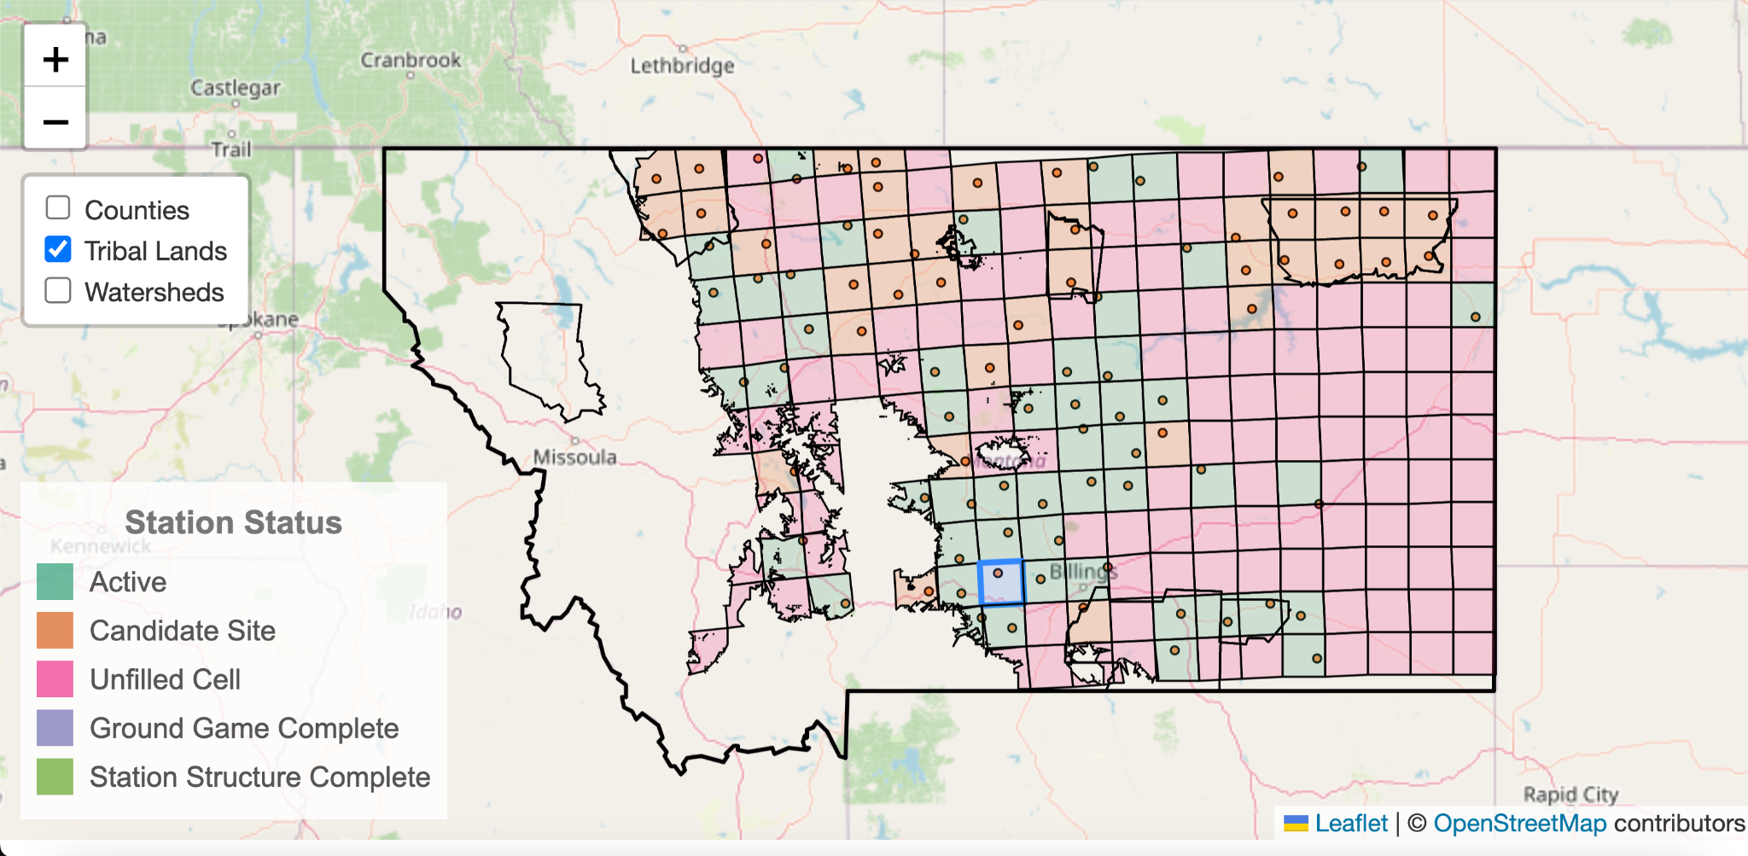
Mesonet Update

Slide 14
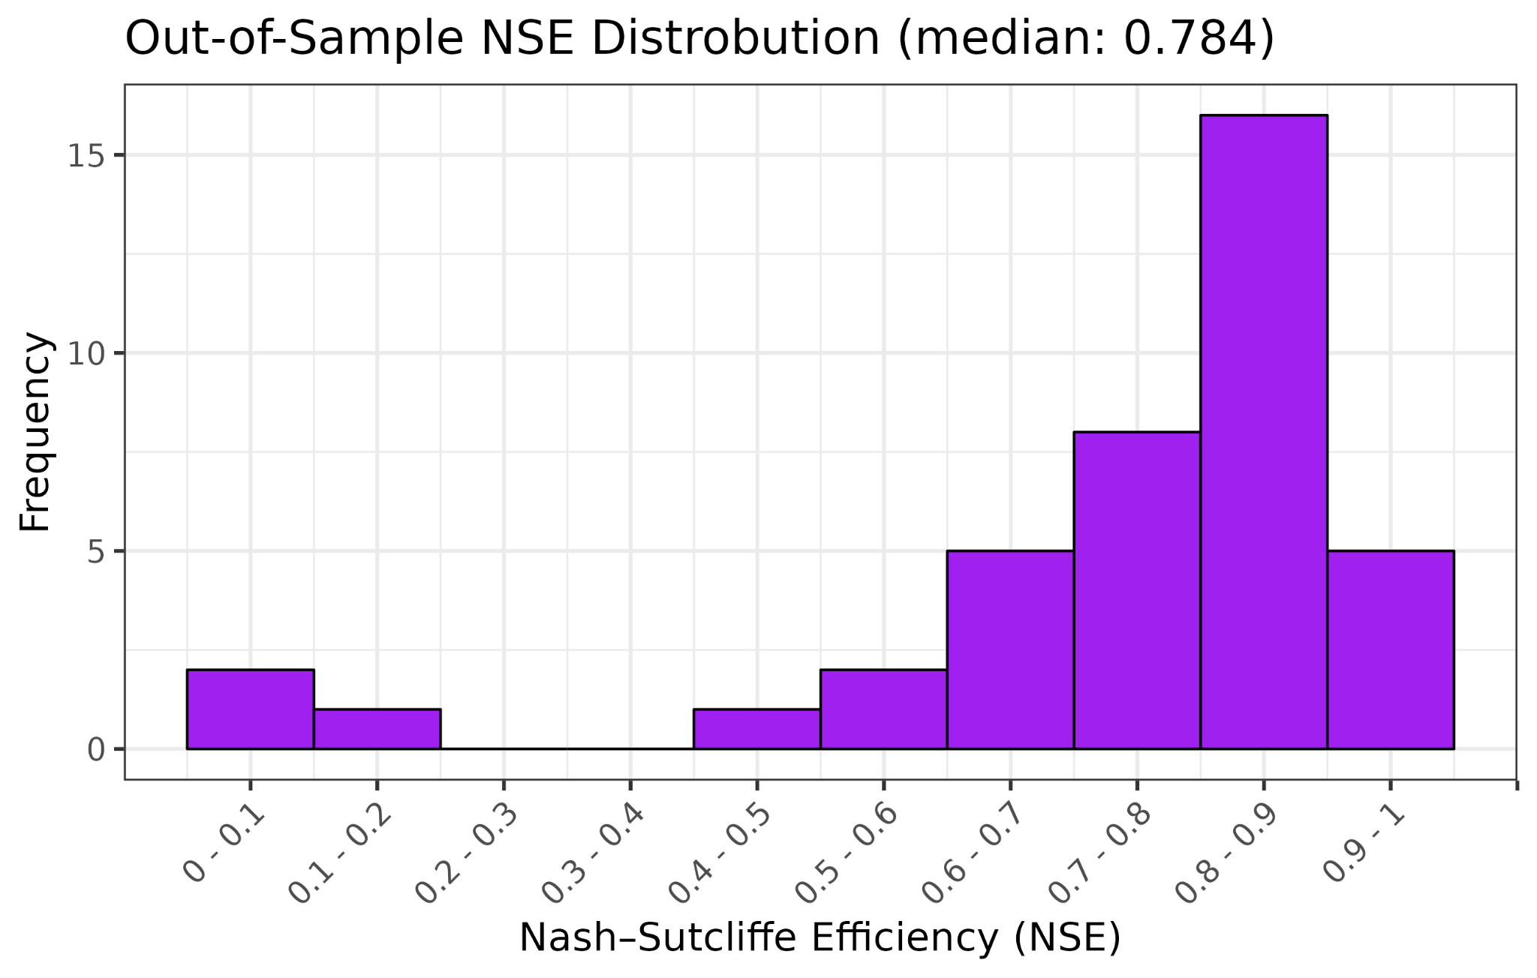
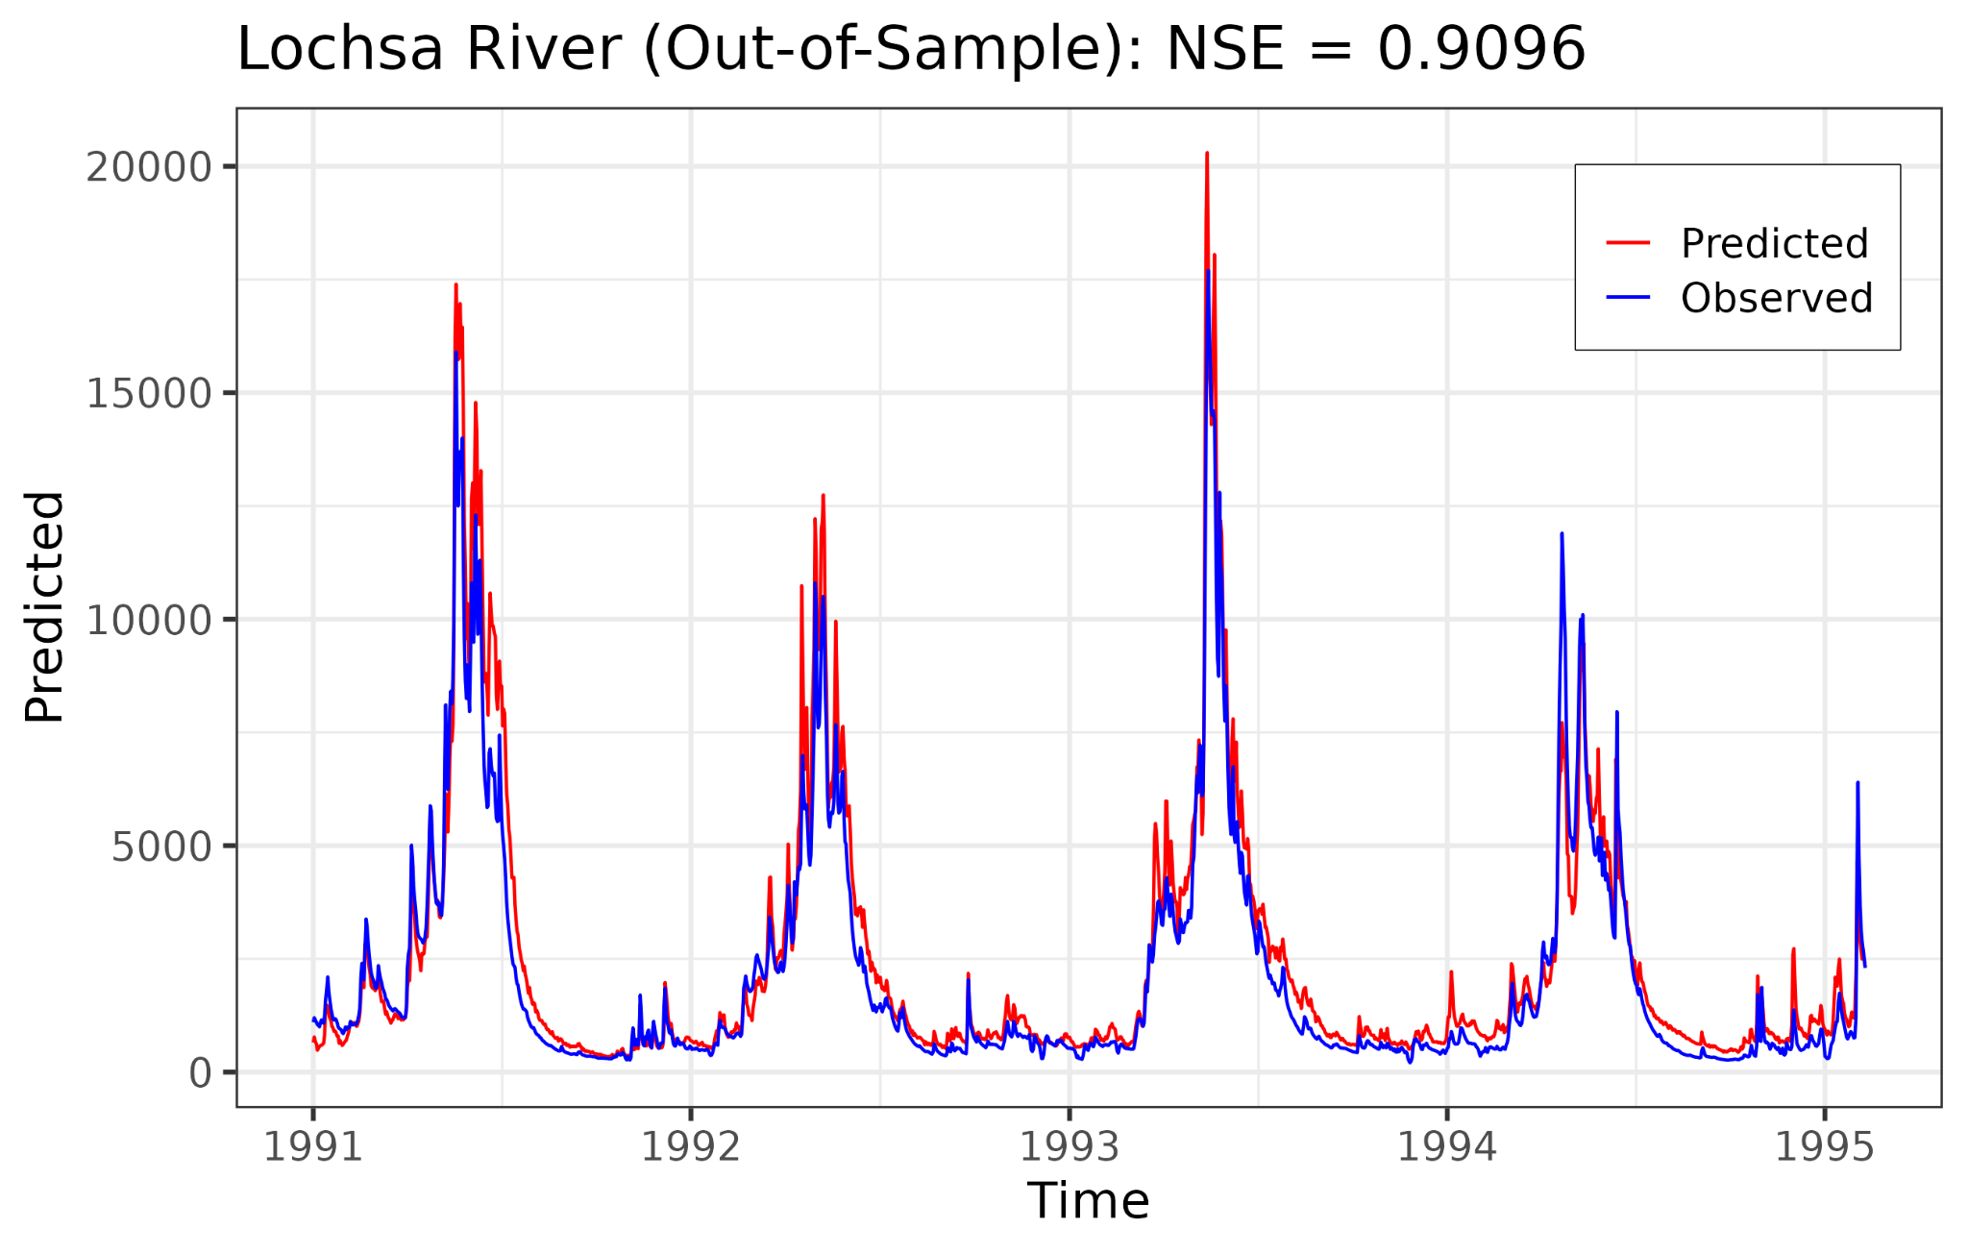
Using Neural Networks to Enhance Montana’s Integrated Hydrological Model
Nash–Sutcliffe Efficiency Coefficient (NSE)
Q_{O} = Obs, Q_{m} = Modeled

Slide 15
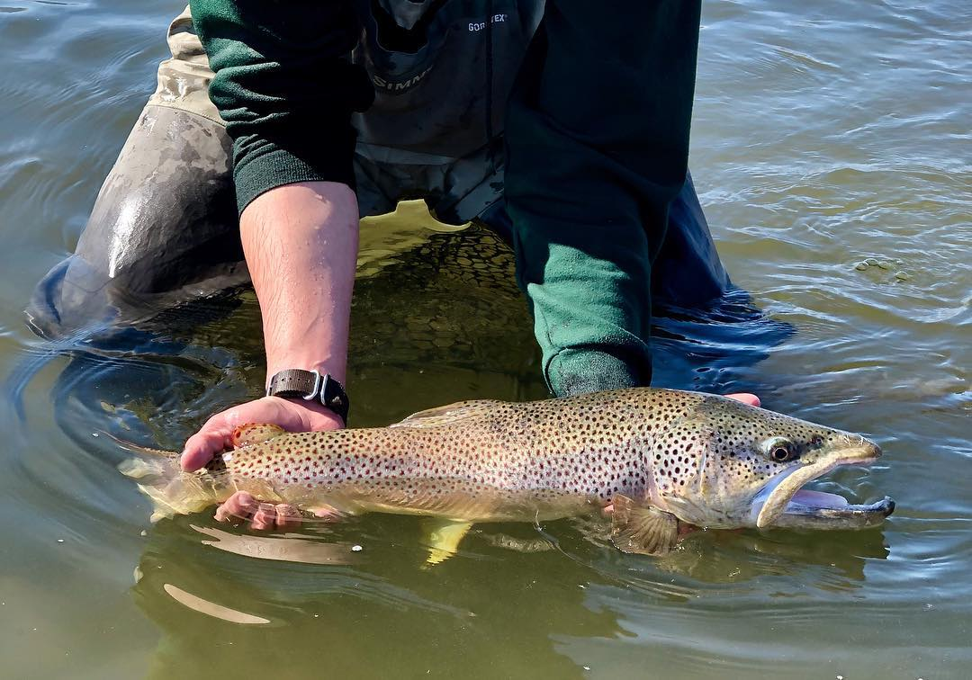
Questions?
zachary.hoylman@umontana.edu
Web Resources:
MCO Web Page: https://climate.umt.edu/
Climate Data Explorer: https://mco.cfc.umt.edu/datasets/
Drought Dashboard: https://drought.climate.umt.edu/
Montana Mesonet: https://climate.umt.edu/mesonet/

